Slide 1

2027 Employee Benefits
Open Enrollment
Open Enrollment Dates: Tuesday, October 20th – Monday, November 2nd
Notes:
Hello and welcome to this year’s benefits open enrollment presentation. During this presentation, you will be provided with an overview of the plans offered to eligible employees and family members, along with resources available to assist you with any benefit-related issues now and throughout the year.

Slide 2
Key Information
The 2027 Benefit Open Enrollment Period is Tuesday, October 20th – Monday, November 2nd
All benefit elections and changes will take effect 01/01/2027
Payroll deductions will begin January 8th
The deadline to enroll is November 2nd
Notes:
The benefits open enrollment period is your opportunity to make changes to your benefit elections and review which dependents you will cover. All benefit elections and changes will take effect on January 1st, and payroll deductions will begin January 8th . Be mindful of the enrollment deadline of November 2nd to ensure your benefits are updated without issue.

Slide 3
Open Enrollment
Opportunity to make changes to your benefit elections and to review which dependents you will cover
Elections made during this period will remain in effect for a 12-month period, unless you experience an IRS-approved “qualifying event”
Approved qualifying events include:
  Marriage or Divorce
  Death
  Birth or adoption of a dependent
  Change in employment status
  Change in dependent’s eligibility status
  Loss of or significant change to your current coverage
  Judgment, decree or court order
You have 30 days from the date of the event (varies by state) to notify Human Resources
Notes:
Open enrollment is the one time per year you can make changes to your benefit plans without a qualifying event. A qualifying event, such as marriage, divorce, or the birth of a child, allows you to make changes mid-plan year. Absent one of these events, the only time you can make changes to your benefit selection is during open enrollment. All elections are effective at the start of your plan year!

Slide 4
2027 Changes
What’s Changed​
New PPO/HDHP (HSA) Medical Plans
Increased Medical Plan Spousal Surcharge
New Dental Carrier SunLife
Dental Orthodontia Dependent Child(ren) Age
New Flexible Spending Account Custodian Surency
What’s Hasn’t Changed​
Your EyeMed Vision benefits​
Your Mutual of Omaha Life and Long-Term Disability benefits
Notes:
What’s Changed​
New PPO/HDHP (HSA) Medical Plans
Increased Medical Plan Spousal Surcharge
New Dental Carrier SunLife
Dental Orthodontia Dependent Child(ren) Age
New Flexible Spending Account Custodian Surency
What’s Hasn’t Changed​
Your EyeMed Vision benefits​
Your Mutual of Omaha Life and Long-Term Disability benefits

Slide 5


Medical/Rx
Notes:
Now, we will review the medical plan options for benefit year.

Slide 6
Medical – Plan Highlights
Anthem | Medical Premium Copay | Medical Basic Copay | Medical HDHP/HSA
Annual Deductible | $3,000 per individual $6,000 per family | $5,000 per individual $10,000 per family | $3,500 per individual $7,000 per family
Annual Out-of-Pocket Maximum | $6,000 per individual $12,000 per family | $9,500 per individual $19,000 per family | $4,000 per individual $8,000 per family
Plan Coinsurance (after deductible) | 80% in most cases | 90% in most cases | 80% in most cases
Office Visit | $30 Copay | $30 copay | 80%, after deductible
Lab & X-ray | 80%, after deductible | 80%, after deductible | 80%, after deductible
Complex Radiology | 80%, after deductible | 80%, after deductible | 80%, after deductible
Inpatient Hospital | 80%, after deductible | 80%, after deductible | 80%, after deductible
Emergency Room | $300 copay | $300 copay | 80%, after deductible
Out-of-Network Benefits are double the In-Network. See the summary of benefits for details.
Employee Contributions (per pay / 24 pays per year) | Medical Premium Copay | Medical Basic Copay | Medical HDHP/HSA
Single | $46.49 | $10.56 | $31.68
EE + Spouse | $143.16 | $121.69 | $104.48
EE + Child(ren) | $115.80 | $98.43 | $83.55
Family | $207.96 | $176.77 | $149.47
Employer Health Savings Account Contribution (when electing HDHP): Single Coverage: $25 / All Other Coverage: $50 per pay
Medical Plan Spousal Surcharge: $125 per pay extra for spousal coverage if the spouse has medical available through their own employer
Tobacco User Rates: $25 upcharge per pay (in addition to selected plan rate)
Notes:
You continue to have three plans to choose from. The Anthem Premium Copay PPO Plan, Basic Copay PPO Plan, and The High Deductible/HSA Plan
First let’s go over the Premium PPO Plan: Your annual deductible is increasing from$2,000/$4,000 to $3,000/$6,000. Your annual out of pocket maximum increased from $5,000/$10,000 to $6,000 individual and $12,000 family. Once you meet your deductible, you will be responsible for 20% of the cost for all services. Office Visits will go to a $30 copay. Preventive services are covered in full.
Next let’s go over the Basic PPO Plan: Your annual deductible is $5,000 individual and $10,000 Family. Your annual out of pocket maximum will increase from $6,000/$12,000 to $9,500 individual and $19,000 family. Once you meet your deductible, you will be responsible for 20% of the cost for all services. This plan lowered Office Visits from $35 to $30 copay and Emergency Room visits from $350 copay to $300. Preventive Services are covered in full.
You also have the High Deductible/HSA Plan: Your annual deductible was updated to $3,500 Individual and $7,000 per family per the IRS guidelines for 2027. Your annual out of pocket maximum is $4,000 per individual and $8,000 per family. Once you meet your deductible, you will be responsible for 20% of the cost for all services. Preventive Services are covered in full, with no deductible. You will also receive $25 per pay for single or $50 per pay for all other tiers into your Health Savings Account from Clermont County to help offset your medical expenses.
Please note that the medical plan spousal surcharge has increased from $50 to $125 per pay for spousal coverage if the spouse has medical available through their own employer.

Slide 7
Prescription Drug– Plan Highlights
CarelonRx | Anthem BCBS Medical Premium Copay | Anthem BCBS Medical Basic Copay | Anthem BCBS HDHP/HSA
Rx Deductible | N/A | N/A | Prescription drug cost are subject to the annual medical deductible
Retail Prescription Drugs 30-day Fill
Generic | $15 copay | $15 copay | 80%, after deductible
Preferred Brand Name | $50 copay | $50 copay | 80%, after deductible
Non-Preferred Brand Name | $90 copay | $90 copay | 80%, after deductible
Preferred Specialty | $90 copay | $90 copay | 80%, after deductible
Mail-Order Prescriptions 90-Day Fill
Mandatory for Maintenance Rx? | N/A | N/A | N/A
Generic | $30 copay | $30 copay | 80%, after deductible
Preferred Brand Name | $100 copay | $100 copay | 80%, after deductible
Non-Preferred Brand Name | $180 copay | $180 copay | 80%, after deductible
Notes:
Here are some further examples of what your cost sharing would be for each plan option, focused specifically on prescription drug benefits.
Let’s take a moment to review your Prescription drug cost as we have changes to some of the copay cost we will also share in next slides saving solutions.
First let’s look at the Premium Copay PPO Plan: There is no deductible for this plan
Retail: Generic: $15 copay, Preferred Brand Name: $50 Copay Non-Preferred Brand Name & Preferred Specialty increase from $70 to $90 copay
Mail-Order: Generic: $30 copay, Preferred Brand Name: $100 Copay, Non- Preferred Brand Name $180 Copay
Next let’s look at the Basic Copay PPO Plan: There is no deductible for this plan
Retail: Generic: $15 copay, Preferred Brand Name: $50 Copay, Non- Preferred Brand Name & Preferred Specialty lowered cost from $100 to $90 Copay
Mail-Order: Generic: $30 copay, Preferred Brand Name: $100 Copay, Non- Preferred Brand Name lowered from $200 Copay to $180.

Slide 8
CarelonRx Maintenance 90 Program
Maintenance drugs are medications taken everyday for conditions like high blood pressure, asthma, heartburn, thyroid disease or diabetes. ​
When using this benefit, you must fill prescriptions for maintenance drugs at an Rx Maintenance 90 pharmacy or through home delivery. ​
Members impacted will be notified by Anthem by mail and will have (2) 30-day courtesy fills before switching to the 90-day fill.​
Benefits of this program are:​
  Getting a 90-day fill but paying for only 60-day.​
  Members receiving 90-day fills at a time, there is a higher rate of coherence with maintenance medications​.
Notes:
Maintenance drugs are medications taken everyday for conditions like high blood pressure, asthma, heartburn, thyroid disease or diabetes. ​
When using this benefit, you must fill prescriptions for maintenance drugs at an Rx Maintenance 90 pharmacy or through home delivery. ​
Members impacted will be notified by Anthem by mail and will have (2) 30-day courtesy fills before switching to the 90-day fill.​
Benefits of this program are:​
Getting a 90-day fill but paying for only 60-day.​
Members receiving 90-day fills at a time, there is a higher rate of coherence with maintenance medications​.

Slide 9
CarelonRx Cost Relief Drug Program
CarelonRx's Cost Relief program helps members get specialty drugs at NO out-of-pocket cost. The program works by: ​
Accessing manufacturer copay assistance. The program works with drug manufacturers to get copay card assistance and maximize available dollars. ​
Managing enrollment and renewals: ​
  The program offers personalized enrollment support and manages renewals. ​
  Specialists provide outreach to manage and coordinate complex and expensive specialty medications. ​
Members can enroll at any time, but members must sign up. This program benefit is not automatic. ​
Only eligible prescriptions filled after enrollment into the program will have a $0 out-of-pocket cost. ​
If a member renews in a plan that includes Cost Relief, they won't need to re-enroll each year. ​
Notes:
CarelonRx's Cost Relief program helps members get specialty drugs at NO out-of-pocket cost. The program works by: ​
Accessing manufacturer copay assistance. The program works with drug manufacturers to get copay card assistance and maximize available dollars. ​
Managing enrollment and renewals: ​
The program offers personalized enrollment support and manages renewals. ​
Specialists provide outreach to manage and coordinate complex and expensive specialty medications. ​
Members can enroll at any time, but members must sign up. This program benefit is not automatic. ​
Only eligible prescriptions filled after enrollment into the program will have a $0 out-of-pocket cost. ​
If a member renews in a plan that includes Cost Relief, they won't need to re-enroll each year. ​

Slide 10
Services to keep in mind…
Lab work processed through a stand-alone LabCorp/Quest location or a facility that sends labs to LabCorp to be processed is covered at 100% as long as it is a covered lab service​
12 Chiropractic visits are covered per plan year​
After 12 visits check with your provider on contracted rates​
30 Physical Therapy visits per plan year​
In-office visits cost a Specialty Copay​
Outpatient visits are subjected to deductible and coinsurance​
24/7 NurseLine, you can connect with a registered nurse who will answer your health questions anytime, day or night. They can help you decide where to go for care and find doctors and other care providers in your area.
24/7 digital support, Building Healthy Families is here to help your family with everything from preconception and pregnancy to childbirth and early childhood. The program features an extensive content library to support diverse families, including single parents, same-sex, or multicultural couples. Log in to anthem.com or the Sydney app to access the library and other tools, such as fertility, diaper change, and feeding trackers; due date calculators; and blood pressure monitoring
Notes:
Lab work processed through a stand-alone LabCorp/Quest location or a facility that sends labs to LabCorp to be processed is covered at 100% as long as it is a covered lab service​
12 Chiropractic visits are covered per plan year​. After 12 visits check with your provider on contracted rates​
30 Physical Therapy visits per plan year​. In-office visits cost a Specialty Copay​. Outpatient visits are subjected to deductible and coinsurance​
24/7 NurseLine, you can connect with a registered nurse who will answer your health questions anytime, day or night. They can help you decide where to go for care and find doctors and other care providers in your area.
24/7 digital support, Building Healthy Families is here to help your family with everything from preconception and pregnancy to childbirth and early childhood. The program features an extensive content library to support diverse families, including single parents, same-sex, or multicultural couples. Log in to anthem.com or the Sydney app to access the library and other tools, such as fertility, diaper change, and feeding trackers; due date calculators; and blood pressure monitoring

Slide 11
How to Choose My Plan
Review your prior year’s medical expenses
Review your total claim costs
Ask yourself these questions:
  Do I anticipate any surgeries or hospitalizations for me or my family in the upcoming year?
  Do I prefer a higher deductible with a lower payroll deduction?
  Am I prepared to pay the high deductible in case of an unexpected medical event?
Notes:
So you may be asking, what plan should I choose?
Review your prior year’s medical expenses
Review your total claim costs
Ask yourself these questions:
Do I anticipate any surgeries or hospitalizations for me or my family in the upcoming year?
Do I prefer a higher deductible with a lower payroll deduction?
Am I prepared to pay the high deductible in case of an unexpected medical event?

Slide 12
Anthem Wellness Program
Anthem covered employees and their covered spouses can each earn up to $200 | Preventive Care | Condition Management | Digital & Wellness Activities
Complete any of the activities sponsored by your employer and you’ll earn rewards to put toward electronic gift cards for select retailers. | Wellness Exam/Well Woman ($50) Diabetic A1C* Lab Test ($25) Cholesterol* Test ($25) Prostate Exam ($25) Colorectal Cancer Screening ($25) Mammogram ($25) | Condition Care ($25) Asthma Diabetes Heart Disease or Heart Failure Chronic Obstructive Pulmonary Disease (COPD) | Log in to Sydney ($25) Log Active Minutes (Max $50) My Health Check-In ($25) Team Challenge 1 ($25) Team Challenge 2 ($25) Team Challenge 3 ($25) Team Challenge 4 ($25)
Program reset on July 1st
Redeem your rewards on the Sydney Health mobile app or anthem.com, under “MyHealth Dashboard” and then select “My Rewards”.
Notes:
The CEBCO Wellbeing Rewards Program is another great way to earn money for focusing on your health. Employees and covered spouses can each earn up to $200 annually.
Core Objectives of program: Improve overall population health, Encourage preventive care utilization, Identify health risks early, Reduce long-term claims costs
Increase member engagement with Anthem tools and resources
Common Eligible Activities
1.) Health Assessments - Online questionnaire through Anthem’s member portal - Covers lifestyle, medical history, and risk factors
2.) Biometric Screenings - Can be completed at LabCorp at $0 dollars - Includes metrics like: Blood pressure, Cholesterol, Glucose and BMI
3.) Preventive Exams – Annual well exams; Age/Gender appropriate screenings
4.) Wellness Programs/Coaching – Weight management and condition management like diabetes and hypertension
5.) Participating in Wellness Activities like walking challenges you can earn dollars.
Reward Structure is Dollar based incentives. Redeeming your rewards through Digital gift cards on My Health Dashboard – Redeem Rewards. You can choose from different vendors like Amazon, Mastercard, The Home Depot and UberEats. You can elect to redeem your entire balance with one digital card or can divide your balance on multiple cards.
Timeline: Activities are defined within the plan window July 1st through June 30st. Rewards are paid after verification of completion and may have a lag of a few days to weeks.

Slide 13


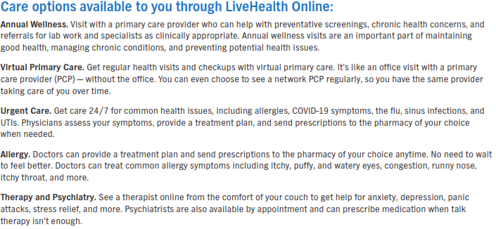

See a doctor wherever, whenever.
9126768 5/19 19-12448
Proprietary information of UnitedHealth Group. Do not distribute or reproduce without express permission of UnitedHealth Group.
Notes:
Virtual Visits. Get access to care online, at any time.
When you need care - anytime, day or night - Virtual Visits can be a convenient option. From treating flu and fevers to caring for migraines and allergies, you can talk to a doctor by video or phone 24/7.
LiveHealth Online Psychiatric lets you visit a psychiatrist or therapist through video chat on your computer or smartphone. Members can see a therapist for 45-minute counseling sessions. Members can also see a Psychiatrist for assistance with managing psychiatric medications but cannot prescribe medication.
Both LiveHealth Online Medical and Psychiatric provide unlimited visits and are provided at a $0 cost for Co-pay plans & $55 per visit for High-Deductible Plan.
Available through the Sydney App, Anthem.com, LiveHealthOnline.com or LiveHealth App

Slide 14

Lark Diabetes Prevention Program
The Lark Diabetes Prevention Program is an all-digital app that can help you lose weight and lower your risk of developing Type 2 Diabetes.
The program is customized based on your lifestyle and you will receive 24/7 coaching to provide you with tools for healthier habits to reduce your risk.
After enrolling, members will receive a free smart scale and after completing several weeks of the program a free Fitbit2 that links with the Lark app to aid in their success.
Go to lark.com/anthem to take the one-minute survey to see if you qualify.
Available dependents 18+ years of age.
Additional Anthem Benefits must be enrolled in medical to be eligible
Notes:
The Lark Diabetes Prevention Program is a digital coaching program designed to help reduce the risk of Type 2 diabetes.
It includes: 24/7 coaching, Personalized guidance, A free smart scale and Fitbit after completing several weeks of the program
And best of all—it’s no cost if you qualify.
It’s a great tool for weight management and healthy habit-building.

Slide 15
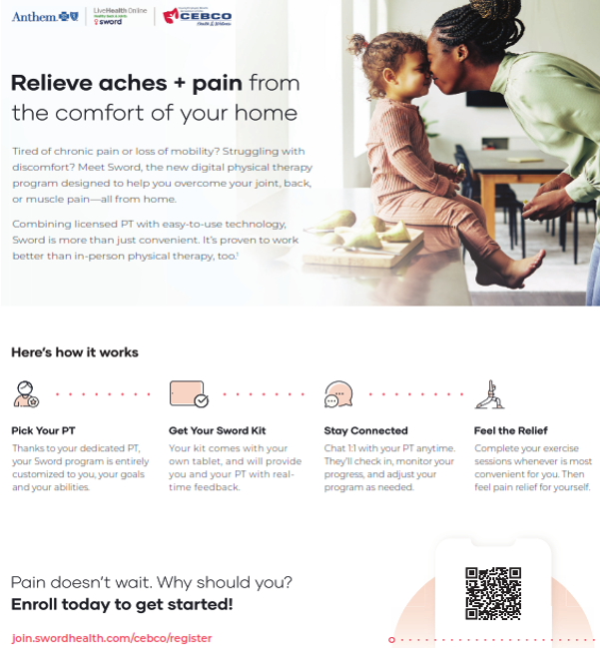
SWORD Program
Additional Anthem Benefits must be enrolled in medical to be eligible
Notes:
Digital physical therapy program. This solution gives access to care that’s convenient​. No cost, no referral, and does not count towards PT visits
Enroll in the program​: Provide clinical information so the PT can tailor the program to you​
Select your PT, schedule first visit, and receive your Kit (tablet and motion sensors)​
Complete digital sessions
How long does the program last? There is no fixed time, but typically 8-12 weeks.​
How long do sessions last? Usually 20-30 minutes.​
How often do I perform the sessions? We recommend 3 to 5 days per week.​
Can I continue after the initial period? Yes, and you can keep your digital therapy kit.​
How do I contact my PT? Through the chat feature on the app, video calls, or by phone.

Slide 16

Bloom
Additional Anthem Benefits must be enrolled in medical to be eligible
Notes:
Relieve pelvic health symptoms from home . 1 in 3 women suffer from pelvic health disorders including bladder issues, bowel dysfunction, and pelvic pain.​
No cost, no referral needed​. Take the onboarding survey​. Select your pelvic health specialist​ & Get your Bloom kit​

Slide 17

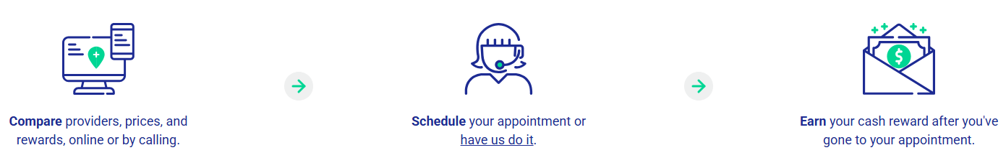
Earn a reward check every time you and your family choose an eligible lower-cost, high-value doctor or facility for a variety of health services. Simply call a SmartShopper representative or register on the website to search for competitive costs and high-quality care for your next procedure or service and get paid doing it! If you choose a cost-effective location for your care, you can earn reward up to $500!
Call 1-866-285-7078 or visit SmartShopper.com to login to start saving!
Notes:
One of the most valuable programs available is SmartShopper. This program rewards you for being a smart consumer when it comes to healthcare. If you shop ahead of time and choose a high-quality, lower-cost provider, you can earn cash rewards—up to $500 per service.
There’s no catch—this program is already included in your health plan. It simply shares the savings with you when you choose a more cost-effective option.
A few key things to remember:
You must shop before receiving the service
You can call or go online—even same-day is okay
If you qualify, a check is mailed directly to you within about 60 days
Common services include MRIs, CT scans, colonoscopies, surgeries, and physical therapy. Reminder for your Wellness visit bloodwork you can earn money.
Bottom line: before you schedule services, check SmartShopper—you could get paid to do it.

Slide 18

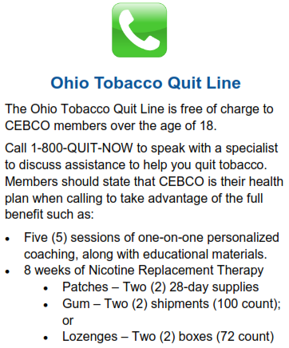
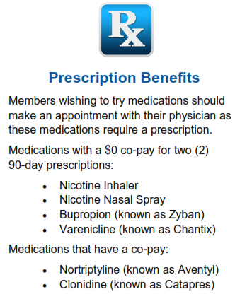

Tobacco Cessation
10055803 7/20 19-14113
Notes:
The Quit For Life program is designed to help you to overcome tobacco dependency. Featuring the latest in digital and online tools such as a website, app, Quit Coach®, text messaging and more, the Quit For Life program is there for your support.
Receive access to a website to access the quit guide, which features tips to help you overcome urges, manage withdrawal symptoms and change your daily habits to avoid tobacco triggers. The site also features other tools such as a cost savings calculator, Live Tobacco-Free course, quizzes and more.

Slide 19

Spending Accounts
Notes:
Now we will cover tax benefit accounts available to you through your employer.

Slide 20

Health Savings Account (HSA)
What is a Health Savings Account (HSA)? A health savings account (HSA) is an account that you can use to pay medical expenses. This account helps offset your medical and prescription costs by giving you tax advantages, allowing your income to stretch farther by using the dollars that would have otherwise been paid in taxes.
BUT there are still a few rules:
You must be covered under an HDHP on the first day of the month.
You must not be covered by another health coverage (a non-qualified medical plan that is not an HSA or a spouse’s full purpose FSA)
You must not be enrolled in Medicare
You must not be claimed as a dependent on someone else’s tax return.
HSA: How Much Can I Contribute for 2027?
Individual Enrollment: $4,500 and Family Enrollment: $9,000
For 2027 Clermont County contributes $25 per pay to your single HSA or $50 per pay to any other tier.
Subtract this amount from your maximum allowed.
Please remember:
These maximums should include any employer contributions.
Those 55 years and older and not enrolled in Medicare can contribute an additional $1,000 “catch-up” each year.
If you have not had an HSA previously you will need to open up an HSA Account at a bank or credit union of your choice.
Notes:
What is a Health Savings Account (HSA)? A health savings account (HSA) is an account that you can use to pay medical expenses. This account helps offset your medical and prescription costs by giving you tax advantages, allowing your income to stretch farther by using the dollars that would have otherwise been paid in taxes.
BUT there are still a few rules:
You must be covered under an HDHP on the first day of the month.
You must not be covered by another health coverage (a non-qualified medical plan that is not an HSA or a spouse’s full purpose FSA)
You must not be enrolled in Medicare
You must not be claimed as a dependent on someone else’s tax return.
You have to spend the dollars on qualified medical expenses and keep itemized receipts.
So, you may be asking, How much can I contribute? 2026 Individual Enrollment: $4,500 & Family Enrollment: $9,000
For 2027: Clermont County contributes $25 per pay to your single HSA or $50 per pay to any other tier.
Please remember:
These maximums should include any Employer + Employee contributions.
Those 55 years and older and not enrolled in Medicare can contribute an additional $1,000 “catch-up” each year.
If you have not had an HSA previously you will need to open up an HSA Account at a bank or Credit Union of your choice.
Keep in mind, banks charge a fee and credit unions do not. Credit Unions usually have better investment opportunities as well.

Slide 21

Flexible Spending Accounts
Healthcare FSA annual maximum - $3,400
  Allows IRS-approved medical, Rx, dental or vision expenses not covered by the insurance plan with pre-tax dollars.
  You can now carryover up to $500 to the following calendar year.
  Full annual election amount available immediately.
  Some examples include:
    Medical and Pharmacy copays and out-of-pocket expenses
    Hearing services, including hearing aids and batteries
    Vision services, including contact lenses and solution, eye exams and eyeglasses
    Dental services and orthodontia
    Over-the-Counter medications when prescribed by a Physician
      Require substantiation for any expenses that are not a copay on the medical or pharmacy plan.
Limited Healthcare FSA - Allows IRS-approved dental or vision expenses not covered by the insurance plan with pre-tax dollars.
  If you are contributing to an HSA account, you can only enroll in the Limited FSA.
Notes:
The Healthcare FSA annual maximum is $3,400. The Healthcare FSA allows IRS-approved medical, Rx, dental or vision expenses not covered by the insurance plan with pre-tax dollars.
You can now carryover up to $500 into 2027. The Full annual election amount is available immediately.
Some examples of eligible medical expenses include:
Medical and Pharmacy copays and out-of-pocket expenses
Hearing services, including hearing aids and batteries
Vision services, including contact lenses and solution, eye exams and eyeglasses
Dental services and orthodontia
Over-the-Counter medications when prescribed by a Physician will Require substantiation for any expenses that are not a copay on the medical or pharmacy plan.
Another option is the Limited Healthcare FSA which allows IRS-approved dental or vision expenses not covered by the insurance plan with pre-tax dollars. It’s Important to know that if you are contributing to an HSA account, you can only enroll in the Limited FSA

Slide 22

Flexible Spending Accounts
Plan Year – January 1 thru December 31
Decision is IRREVOCABLE for the entire plan year!
Be conservative! The IRS has a strict “Use it or Lose it” rule. If you do not use the full amount in your FSA, you will lose any remaining funds (except the $500 rollover for the HealthCare FSA).
  Adjustments can be made if a “qualifying event” (marriage, divorce, death, birth, adoption) occurs.
  You cannot transfer funds from one FSA to another.
  The plan provides a Grace Period.
  You have until March 31st to submit claims for reimbursement.
  You cannot have a Healthcare FSA and an HDHP plan, unless you have a Limited Purpose FSA Plan.
Notes:
The Plan Year is January 1 thru December 31st Your Decision is IRREVOCABLE for the entire plan year!
Be conservative! The IRS has a strict “Use it or Lose it” rule. If you do not use the full amount in your FSA, you will lose any remining funds (except the $500 rollover for the HealthCare FSA).
Adjustments can be made if a “qualifying event” (marriage, divorce, death, birth, adoption) occurs.
You cannot transfer funds from one FSA to another.
The plan provides a Grace Period
You have until March 31st to submit claims for reimbursement.
You cannot have a Healthcare FSA and an HDHP plan, unless you have a Limited Purpose FSA Plan

Slide 23

Dependent Care FSA Plan
Dependent care FSA annual maximum is $7,500. Features of this plan include:
This program lets you pay for certain IRS-approved dependent daycare expenses with pre-tax dollars.
Rollover provision does not apply. Use it or lose it rule applies.
Eligible for care while parents are at work or school.
ONLY amount payroll deducted to date is available for distribution.
Some examples include:
  Daycare/Preschool for dependent children to age 13
  Adult daycare
  Before and after school programs
  Camps
Notes:
Dependent Care FSA Plan the annual maximum for 2027 is $7,500. Features include: this program lets you pay for certain IRS approved dependent daycare expenses with pre-tax dollars. Rollover provision does not apply. Use it or lose it rule applies. Some examples of dependent care include: daycare, preschool for dependent children to age 13, adult daycare, before and after school program and camps.

Slide 24

Dental
Notes:
Now, let’s review dental plan options.

Slide 25
Dental - Benefit Highlights
MetLife | Basic Plan | Premium Plan
 | In-Network Benefits | In-Network Benefits
Individual | $50 applies to Basic and Major Benefits only | $50 applies to Basic and Major Benefits only
Family | $150 applies to Basic and Major Benefits only | $150 applies to Basic and Major Benefits only
Annual Maximum Per Covered Member | $1,000 | $1,500
Preventive Coverage | 100% | 100%
Basic Coverage | 80% | 80%
Major Coverage (Inc. Implants) | 50% | 50%
Orthodontia Benefit | Not Covered | 50%
Orthodontia Dependent Child(ren) | Not Covered | Covered Limited to eligible dependent children under age 26
Orthodontia Lifetime Maximum | Not Covered | $1,500
Dental (per pay/24 pays per year) | Basic Plan | Premium Plan
Single | $15.20 | $17.18
EE + Spouse | $41.66 | $48.50
EE + Child(ren) | $38.36 | $44.64
Family | $46.52 | $54.18
Notes:
We will continue to have 2 dental plan options through new Dental Carrier Sun Life for the Basic and Premium Plans.
The only plan difference are The Basic Plans features an $1,000 annual maximum benefit per family and The Premium plan features a $1,500 annual maximum benefit per family. Also, the Premium Plan has an Orthodontia benefit for dependent child(ren) to age 26.
The benefit guide includes How to find a provider website link and steps.

Slide 26

Vision
Notes:
Next, let’s review vision benefits through new carrier EyeMed.

Slide 27
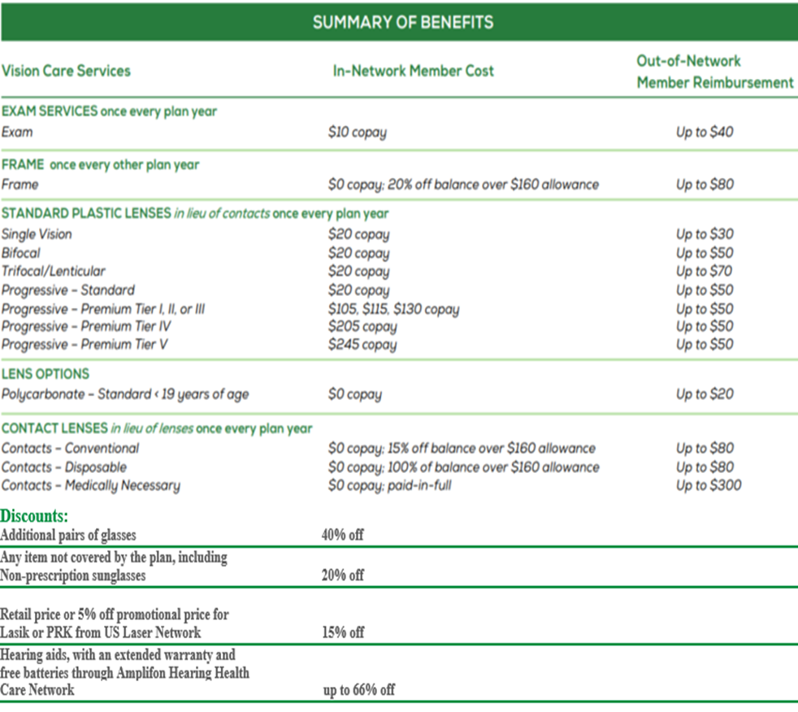

Vision – Benefit Highlights
Vision - EyeMed (per pay/24 pays per year)
Single | $2.53
EE + Spouse | $5.31
EE + Child(ren) | $6.08
Family | $7.29
Notes:
No plan or carrier changes for vision. EyeMed.
Continue to cover exams, frames, lenses and contacts.

Slide 28

Life and disability benefits
Notes:
Life and Disability benefits continue through Mutual of Omaha.

Slide 29
Basic Life/AD&D
Clermont County provides $25,000 Basic Life and $25,000 AD&D benefits to all eligible full-time employees at no cost to you*.
The Life insurance benefit will be paid to your designated beneficiary in the event of death while covered under the plan. The AD&D benefit will be paid in the event of a loss of life or limb by accident while covered under the plan.
*Does not apply to CCDD employees – see your personnel department for details.
Please be sure to review and update your beneficiary information as needed; does not have to be done during Open Enrollment.
Notes:
Clermont County continues to provide $25,000 Basic Life and $25,000 accidental death and dismemberment benefits to all eligible full-time employees at no cost to you. The Life insurance benefit will be paid to your designated beneficiary in the event of death while covered under the plan. The accidental death and dismemberment benefit will be paid in the event of a loss of life or limb by accident while covered under the plan.
*This benefit does not apply to CCDD employees – see your personnel department for details.
Friendly reminder this is a good time to review and update your beneficiary information.

Slide 30
Voluntary Life Insurance
New Hire / New Benefit Eligible Employees | New Hires can elect up to up to $250,000; can apply for up to $500,000 maximum by completing an EOI* (Evidence of Insurability) Elect up to $50,000 for spouse without EOI Elect child life up to $20,000 without EOI Spouse and/or child(ren) coverage cannot be more than the employee’s own voluntary life coverage.
CHANGES PERMITTED DURING OPEN ENROLLMENT:
Employee | Employees currently enrolled in Voluntary Life may: Maintain current coverage. Increase coverage by up to $10,000 during open enrollment without EOI, provided the election amount does not exceed the Guarantee Issue amount $250,000 Decrease coverage or cancel coverage. Maximum coverage is $500,000.
Spouse | Spouses currently enrolled in Voluntary Dependent Spouse Life may: Maintain current coverage. Increase spouse coverage with an EOI. Maximum coverage is $300,000 with approved EOI but may not exceed 100% of the employees’ own coverage.
Child(ren) | Can elect up to $20,000 (increments of $5,000) Maximum is $20,000 (one policy covers all children in the family) Dependent child(ren) coverage cannot exceed 100% of the employee’s own coverage.
Evidence of Insurability (EOI) | You will be required to submit an EOI if requesting: Employees or spouses who previously declined Voluntary Life coverage must complete EOI and receive underwriting approval before coverage can become effective. If Employee or spouses elect over the Guarantee Issue amount.
ENROLLMENT NOTES: Enter the coverage amount in ESS – the system will calculate the per pay deduction based on age.
*EOI is the acronym for Evidence of Insurability (a medical information declaration).
Notes:
In addition to the employer paid Basic Life and accidental death and dismemberment coverage, you have the option to “buy-up” voluntary life insurance and accidental death and dismemberment coverage. Cost of coverage depends on the amount of coverage you elect and your current age. For this open enrollment year you as the employee can elect up by one $10,000 increment up to $250,000 guarantee issue without medical questions. Any amount over $10,000 increase EOI would be required. You can elect to increase spouse voluntary life EOI is required. You can elect child life up to $20,000 without EOI. Please note Spouse and or Children coverage cannot be more than the employee’s own voluntary Life coverage.
Enrollment Note – enter the coverage amount in ESS the system will calculate the per pay deduction based on age.

Slide 31
Long Term Disability
Clermont County provides you with long-term income protection through Mutual of Omaha Financial in the event you become unable to work due to a non-work-related illness or injury until you have 5 years of OPERS service. The following highlights details regarding our long-term disability plan.
*Employees with 5 or more years of service may qualify for a similar benefit through the Ohio Public Employees Retirement System
 | Mutual of Omaha Long-Term Disability (LTD)
Elimination Period | 180 days
LTD Benefit | 60% up to a monthly maximum of $5,000
Definition of Disability | 3 years own occupation
Maximum Disability Period | Social Security normal retirement age.
Pre-Existing Condition Limitations | 12 months for conditions treated within the 12 months prior to effective date of coverage
Notes:
Clermont County provides employees long-term income protection through Mutual of Omaha with less than 5 years of OPERS service. This long-term disability plan:
The Elimination Period is 180 days
The Long-Term Disability is 60% up to a monthly maximum of $5,000
The Maximum Disability Period is to Social Security normal retirement age
Pre-Existing Condition Limitations is 12 months for conditions treated within the 12 months prior to effective date of coverage.
Note: Employees with 5 or more years of service may qualify for a similar benefit through the Ohio Public Employees Retirement System.

Slide 32
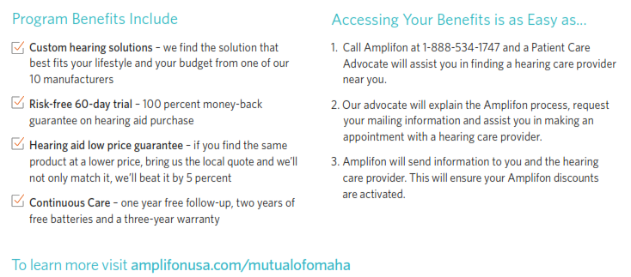

Mutual Solutions Hearing Discount Program
Notes:
Mutual of Omaha provides Amplifon Discounted Hearing program. Access to: Discounted hearing testing, low pricing on hearing aids, 60-day risk free trial period and 2 years batteries with purchase. To activate your benefits, call 1-888-534-1747 today or to learn more information found the website.

Slide 33

Supplemental plans
Notes:
Next, details on the Supplemental plans.

Slide 34
Supplemental Plans
Clermont County also offers a wide selection of supplemental plans. Supplemental plans are available for full-time and also part-time employees who are regularly scheduled to work 20 hours or more per week.
The Standard Cancer Coverage
The Standard Critical Illness
The Standard Accident Insurance
The Standard Universal Life Insurance
Trustmark Voluntary STD (Short-term Disability) Insurance
Trustmark Voluntary LTD (Long-term Disability) Insurance
For Additional Information and rates, call Star Robbins Company: 800-486-7721
Open Enrollment for these supplemental coverages will take place in May 2027 and is effective June 1, 2027.
Notes:
Clermont County Supplement plans have a separate enrollment period which will take place in May 2027 to be effective June 1st 2027.

Slide 35


Resources
Notes:
Finally, let’s review some resources which can also be found in Benefit Guide.

Slide 36
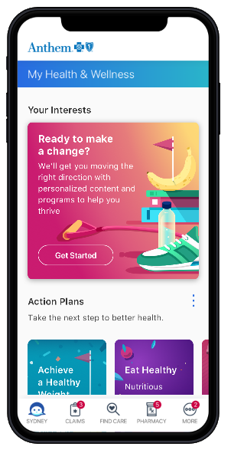
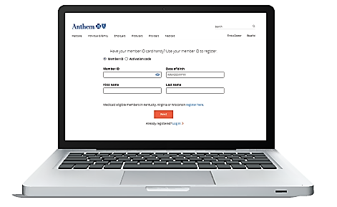
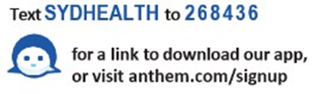


If If you haven’t done so already…Register Today!you haven’t done so already…Register Today!
Got to Anthem.com/register
Provide the information requested
Create a username and password
Set your email preferences
Follow the prompts to complete your registration
Download the free Sydney mobile app and Select Register
Confirm your identity
Create a username and password
Confirm your email preferences
Follow the prompts to complete your registration
36
Need help signing up? Call your member services number on the back of your Anthem ID card.
Notes:
If you haven’t done so already…Register Today. You can register from computer or mobile device. Utilizing both Anthem.com and Sydney mobile app. Need help signing up? Call your member services number on the back of your Anthem ID card.

Slide 37
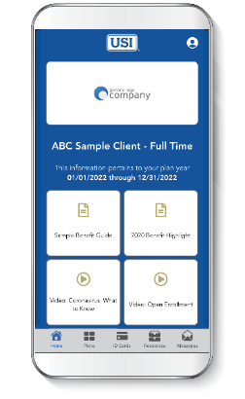
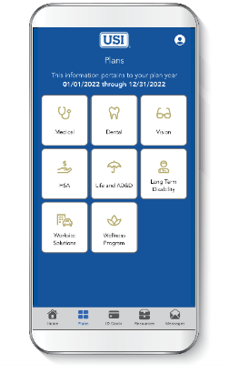
Benefits Mobile App
MyBenefits2GO provides on-the-go access to your benefit plan details, HR contact information and more!
MyBenefits2GO is a quick and simple way for you and your enrolled dependents to access benefit summaries and other important information about our group plans. Store photos of ID cards and easily locate carrier and HR contact information—all in one place. The app is free and available for iPhone and Android.
Download in the App Store or Google Play Store and enter code G28511 in the app to access your benefits.
Stay Organized
Store your benefit plan information and ID cards in one easy-to-find place.
Lighten Your Wallet
Save a photo of your ID card for each plan so you always have it when you need it.
Get In Touch
Find the contact information for carriers and HR all in one spot.
Notes:
The USI EB app provides a quick and simple way for you and your benefit plan participants to access benefit summaries and other important information about your group plans. The app also offers the ability to take photos of ID cards to store on the phone, as well as a way to easily locate carrier and HR contact information—all in one place—24/7 and on the go.
Download in the App Store or Google Play Store and enter code G28511 in the app to access your benefits.

Slide 38





Life is filled with change and uncertainty. The responsibilities and demands on our time can be overwhelming. It happens to all of us. Whenever you or your immediate family members need help dealing with life’s challenges, our Employee Assistance Program, administered by ComPysch is here to help.
You and your dependents have access to five (5) free face to face sessions or to other resources per year provided by Clermont County employees and their immediate family members through ComPsych. Services include:
For full list of resources please go online.
To schedule a confidential appointment: Call: 877.327.4452 TTY: 800.697.0353
Your toll-free number gives you direct, 24/7 access to a GuidanceConsultantSM, who will answer your questions and, if needed, refer you to a counselor or other resources.
Online: guidanceresources.com
App: GuidanceNowSM
Web ID: EAPCEB
Log on today to connect directly with a GuidanceConsultant about your issue or to consult articles, podcasts, videos and other helpful tools.
Notes:
Employee Assistance Program (EAP) is offered to all employees of Clermont County at no cost.
Clermont County employees, spouses/partners and dependents in the home are eligible for up to 5 confidential counseling sessions per issue with a licensed counselor.
EAP is not just for mental health, offers support for many aspects of life such as; Legal & Financial Guidance, Elder and Child Care, Retirement planning and Home mover or repair just to name a few.
These sessions can be by telephone, video or in-person sessions and are completely confidential.
You can call to schedule an appointment or go online and access resources. Coverage is effective day one of employment.

Slide 39

Benefit Resource Center
Contact the USI Benefit Resource Center (BRC) for free, confidential help!
  Benefit coverage levels
  Carrier information
  Claims assistance
  Billing issues
855-874-0829
BRCMidwest@usi.com
Monday through Friday 8:00am to 5:00pm Eastern & Central Standard Time
Notes:
USI’s Benefit Resource Center is a group of USI Employees that are ready and standing by to take your benefit questions and help resolve any issues you may have. Whether you’d like help deciding which plan may be best for you, or simply need a new ID card, the BRC is there to help. The BRC is available by phone at 855-874-0829 or by email at BRCMidwest@usi.com

Slide 40
Website Links
Clermont County Employee Benefit Website: www.hr.clermontcountyohio.gov
Anthem: https://www.anthem.com/ and Carelon Rx: https://www.carelonrx.com/
Medical insurance provider and prescription coverage.
Bloom: https://meet.swordhealth.com/bloom/cebco
1 in 3 women suffer from pelvic health disorders including bladder issues, bowel dysfunction, and pelvic pain. Sword Health developed Bloom to give you relief with an easy-to-use, at-home pelvic therapy solution.
Carelon Rx Cost Relief Program: The Cost Relief program offers you select specialty medicines at no cost to you. That means a $0 copay when you fill the prescription with the exclusive specialty pharmacy in your network. Please call 877-638-4008 Monday through Friday from 8 a.m. to 8 p.m. ET
ComPsych Guidance Resources is our Employee Assistance Program (EAP) : www.guidanceresources.com
EAP program provides 5 free sessions per incident for finding child or elderly care/ movers/ home repair/ pet care, free legal consultation: divorce/ adoption/ wills/ trusts, retirement planning/ insurance/ budgeting/ bankruptcy and an online library with articles/ podcasts/ videos/ on-demand training.
Lark: https://www.lark.com/anthem
The Lark Diabetes Prevention Program is an all-digital app that can help you lose weight and lower your risk of developing Type 2 Diabetes. Available to dependents 18+ years of age.
LiveHealth Online: https://livehealthonline.com/
Online Medical lets you visit a doctor 24/7.
Mutual of Omaha/Amplifon Hearing Discount Program https://amplifonusa.com/mutualofomaha
Special money-savings offers and FREE hearing screening appointment . Call 1-888-534-1747.
SmartShopper: https://smartshopper.com/
Earn a reward check every time you and your family choose an eligible lower-cost, high-value doctor or facility for a variety of health services.
Sword: https://meet.swordhealth.com/thrive/cebco
The Sword digital physical therapy programs combine guidance from dedicated physical therapists with easy-to-use technology that result in real, meaningful results. Available to dependents 13+ years of age.
Sydney Health: https://www.sydneyhealth.com/
Wellness Plan and so much more!
Notes:
This slide includes all the key websites for the programs we covered today.
If you’re ever unsure where to go, this is a great reference point for accessing your benefits.

Slide 41
Thank you!!
Thank you for your participation in this year’s open enrollment presentation.
All election changes are due by:
Monday, November 2nd
Failure to elect medical, dental, vision or FSA will result in no coverage for 2027. Your next opportunity to make changes to your benefits will be if you experience a life event.
Notes:
Thank you for your participation in this year’s open enrollment presentation. Make sure to complete your election changes by the end of the enrollment period. Failure to elect medical, dental, vision or FSA will result in no coverage for 2027. Your next opportunity to make changes to your benefits will be if you experience a life event.

